Slide 1

I/DD February
Lunch(ish) and Learn
February 26, 2026

Slide 2


Kim Barboza, Product Owner and Technology Manager
How long have you been with HHA? 8 years
Favorite part of the software? Configuring requirements
What do you do in your free time? Volunteer with Toledo TOPSoccer, a program that adapts the game of soccer for those with diverse abilities.
Olivia Karem, Implementation Specialist
How long have you been with HHA? 7 years
Favorite part of the software? Configuring security
What do you do in your free time? Take care of my fur babies Tilly and Otto and Knitting.

Slide 3
Agenda
DataPlus Message Center Dynamic Groups
Staff Scheduling Staff Initiated Find Substitute Workflow
Employee Care and Client Care Enhanced Save Options
Employee Care and Client Care Enhanced Field Options
Time Tracking Enhanced Notes Functionality

Slide 4

But first… the I/DD Product Roadmap
Three Focused Workstreams
Current Development
New Development
New development roadmap drafted
Introducing features previously developed during the AWS migration period
Focus groups temporarily replacing CAB to engage a broader set of customers
Continued progress on core performance improvements
Current focus: redesign of flag checking and hourglass processes
Next phases: security enhancements, screen load performance, and sync optimization
Execution will begin once performance work is complete and new resources are fully onboarded
New Features Rollout

Slide 5
DataPlus Message Center
Dynamic Groups

Slide 6
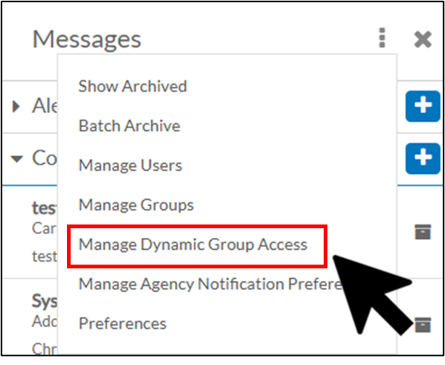
What are Dynamic Groups?
A way to send messages to a predefined group, like all Managers or all Directors, all at once without selecting individual names. Using your agency’s position structure, Message Center makes it easy to reach the right audience quickly and accurately.
Faster communication
Fewer manual steps
More accurate targeting
Clear alignment with your organizational hierarchy.

Slide 7
Dynamic Group Details
How It Works
Choose recipients directly from the message center.
Message is automatically sent to everyone currently in that group.
No need to search for or add individual users
What to Know
Messages are sent to members of the group at the time you send them.
Group membership is based on your agency’s setup.
Message Center administrators grant access for this feature.
Error message will appear if no recipients exist.
When You Might Use This
Announcing deadlines or action items for managers.
Sharing updates that only apply to directors.
Sending reminders for reporting or approval.
Emergency notifications.

Slide 8
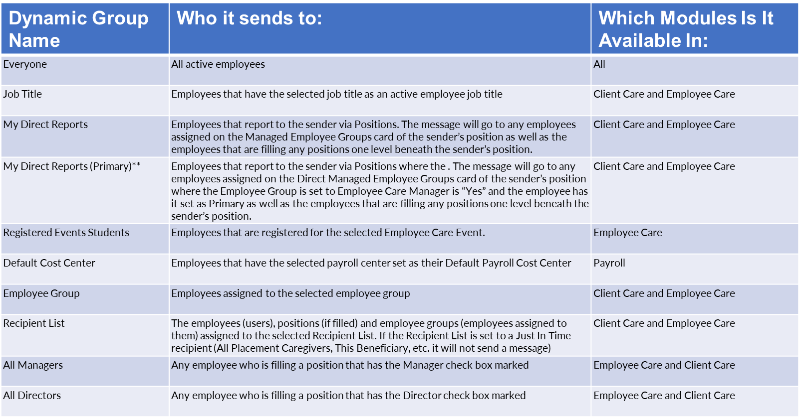
Dynamic Group Options

Slide 9
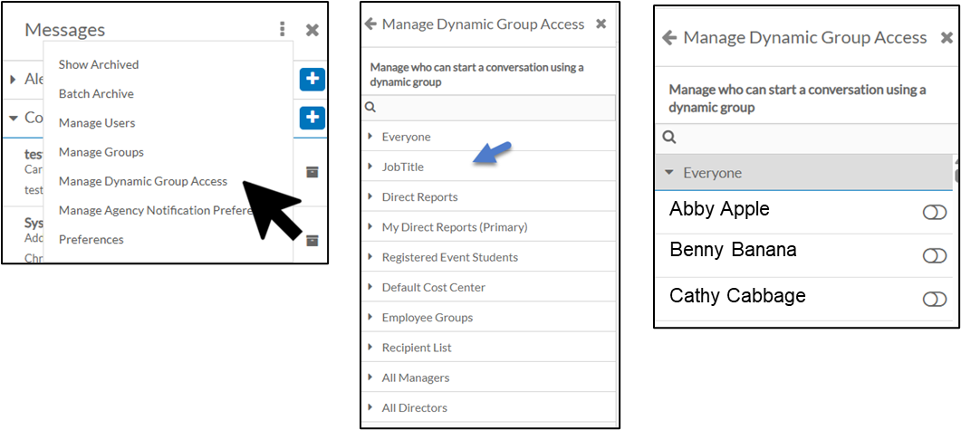
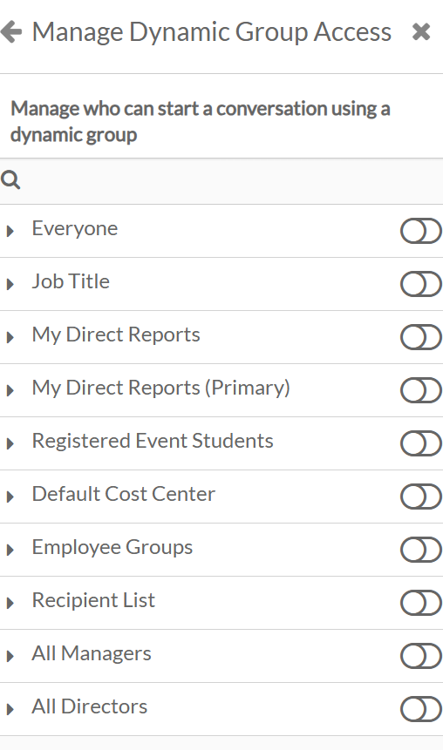
Maintaining Dynamic Groups
Go to the Message Center and click the 3 dots to get to the Config screen.
Click Manage Dynamic Group Access.
Select the Dynamic Group you want to manage access to.
Toggle on or off the users that can access the dynamic group.

Slide 10
Staff Scheduling
Find Substitute Workflow

Slide 11
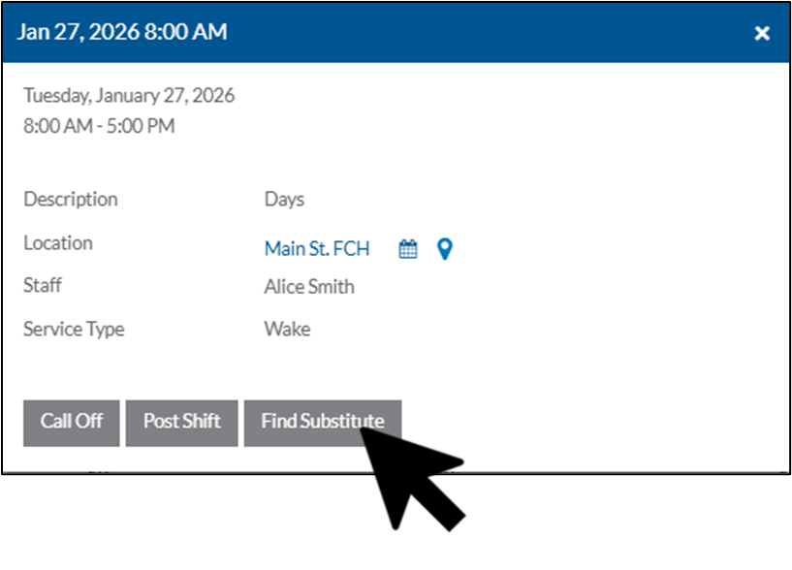
What is “Find Substitute”
The Request Substitute feature lets staff find qualified colleagues to cover shifts, send them a Message Center link, and post the shift to the Trade Board for pickup. Optional manager approval ensures accurate coverage and streamlines the swap process.
Simplifies finding qualified substitutes.
Reduces scheduling errors and coverage gaps.
Provides visibility for staff and managers.
Maintains control with optional approvals.

Slide 12
Find Substitute Details
How It Works
Select a shift and find eligible substitutes.
Send them a Message Center link.
Shift shows as pending and can be picked up via Trade Board.
Manager approval may be set, per location.
What to Know
Only staff approved and available can be selected as substitutes.
Substitutes are notified of swap request.
Shift will show for staff until swap is finalized.
Rejected/denied shift swaps will remain on the Trade Board.
When You Might Use This
You can’t work a scheduled shift and need coverage.
You want to quickly notify eligible colleagues to fill a shift.
You need manager-approved shift swaps.

Slide 13
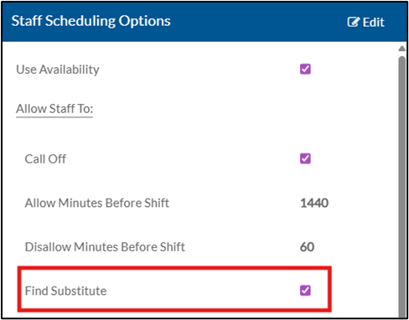
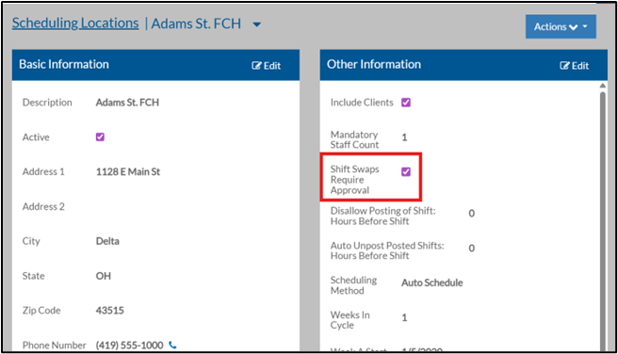
Find Substitute Setup
Setup Shift Swapping in DataPlus
Go to Setup > Staff Scheduling > Options.
Under Staff Scheduling Options check the box Find Substitute.
Add Approval Option at Scheduling Location
Go to the Scheduling Location you would like Manager Approval for shift swaps.
In the Other Information Section, check the Shift Swaps Require Approval checkbox.

Slide 14
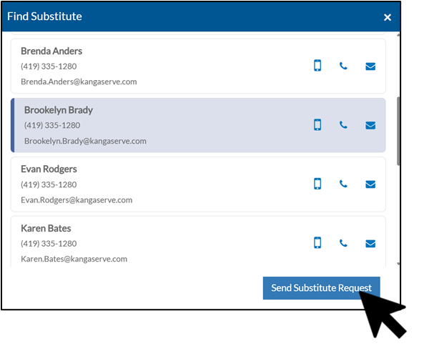
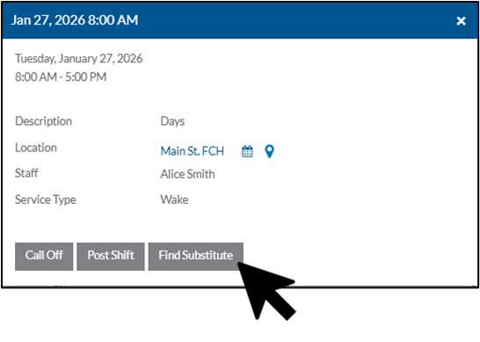
Finding a Substitute
Go to My Schedule.
Locate the shift you’d like a substitute for. Open shift and click Find Substitute.
Select the employee you want to take this shift, then click Send Substitute Request.

Slide 15
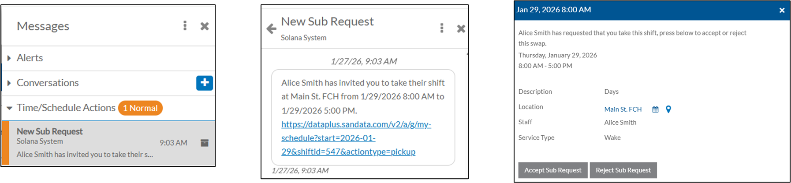
Accepting a Sub Request
The caregiver who the shift was assigned to will then see a message in the Message Center under the Time/Schedule Actions section. If they click the link in the message, it will bring them to the shift. From here select Accept Sub Request to take shift or Reject Sub Request to reject the change.

Slide 16
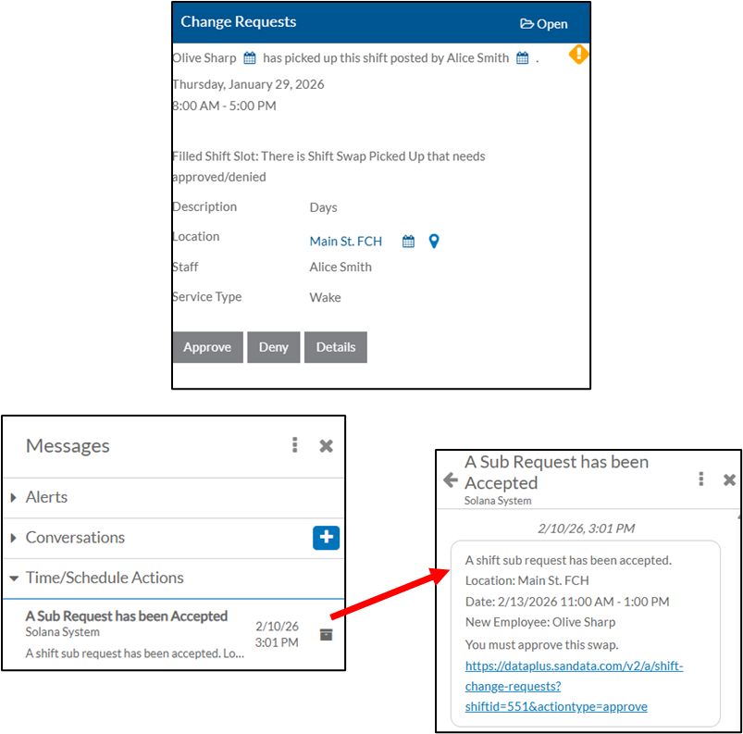
Approving a Sub Request
Once the shift has been accepted by the substitute, if set up, a notification will appear in the Manager’s Change Log and a message will appear under the Message Center in the Time/Schedule Actions folder for them to approve, deny, or view details.

Slide 17
A Closer Look Inside the Platform
Dynamic Groups Overview
Find Substitute Workflow Review
Now, we’ll jump into the system and highlight the key visuals — including the actual pages and fields.

Slide 18
Employee Care and Client Care
Enhanced Save Options

Slide 19
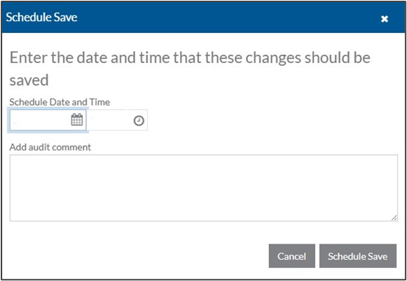
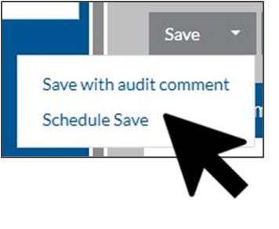
Scheduled Save / Save with Audit Comments
You can schedule your saved changes to run later, review what’s scheduled, and add comments that appear in the audit log. This capability, previously available only in ProviderPro, is now also available on the web in Employee Care and Client Care. Control when changes take effect.
See upcoming changes before they run.
Improve accountability with audit comments.
Provides a consistent experience across the web and ProviderPro.

Slide 20
Scheduled Save / Save With Audit Comment Details
How It Works
Save a change for now or in the future.
Review pending scheduled changes.
Add an optional audit comment to explain the change.
What to Know
Scheduling and audit comments are separate actions.
Scheduled changes use the most current data at execution time.
Audit comments appear after the save completes.
When You Might Use This
You want changes to take effect after hours or at a specific time.
You need to prepare changes in advance.
You want visibility into what changes are pending.
You need to document why a change was made, even if it runs immediately.

Slide 21
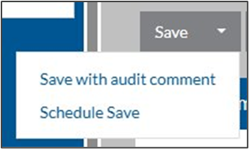

Scheduling a Save
Open the record you want to schedule changes for or add a new record.
Make any edits or complete the information in the new record as needed.
Select the arrow on the Save button, then select Schedule Save.
Select the date and time the save should occur. Enter comments about the reason for the change. Click Schedule Save.
Audit comments will appear in the audit log viewer.

Slide 22
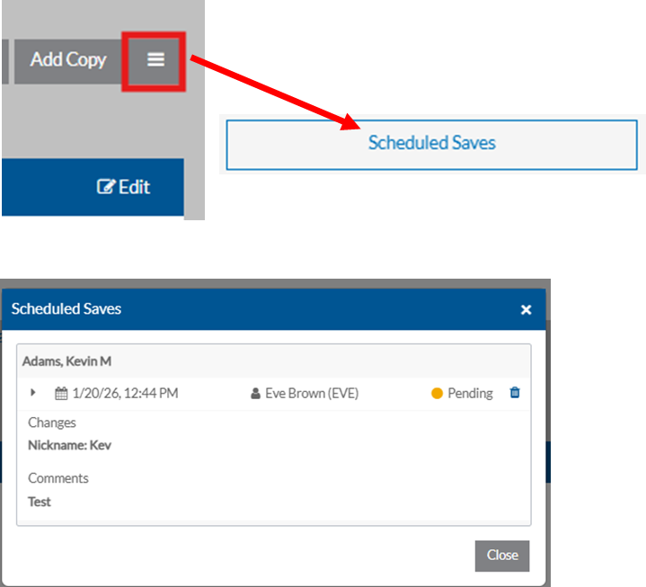

Reviewing Scheduled Saves
Before a change is generated from a scheduled save, a banner will appear on the item that has a Pending change stating Changes are Pending. This can be clicked on to reveal the scheduled change log.
To view all Scheduled Saves, click on the hamburger menu. Click on Scheduled Saves.
This will pull up the Scheduled Saves. The Scheduled date and time will appear, as well as who scheduled the change, the current change status, what change was made, and any audit comments.

Slide 23
Employee Care and Client Care
Enhanced Field Options

Slide 24
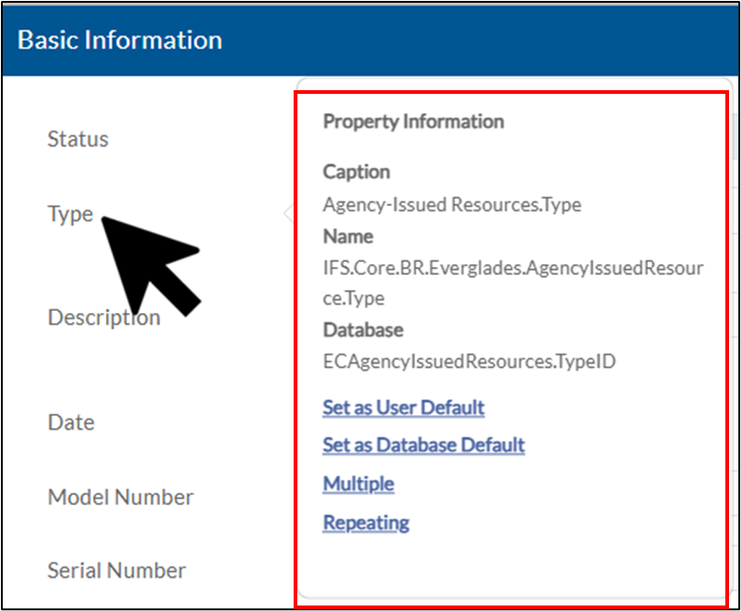
Default/Multiple/Repeating Values and Audit Trail
Field Label Options are now available on the web in Employee Care and Client Care, extending functionality from ProviderPro. Users can view field details, set User or Database defaults, enter multiple values, and use Repeat Value for faster, continuous data entry.
Speeds up data entry and reduces repetitive work.
Improves accuracy with defaults and multiple values.
Supports continuous entry for high-volume updates.
Makes field details visible for better understanding.
Provides a consistent experience across web and ProviderPro.

Slide 25
Default/Multiple/Repeating and Audit Trail Details
How It Works
Access options by left-clicking on the field label.
View field properties and details.
Set Defaults as permitted.
Enter multiple values when needed.
Use Repeat Value to quickly re-enter the same value for the same field.
What to Know
Users must have permissions to set database defaults.
Multiple values and repeat entry are supported only on fields designed for them.
When You Might Use This
Quickly enter the same value across multiple records.
Save commonly used values as user defaults for faster entry.
Enter multiple values for a field when required.
Understand field properties before entering data.

Slide 26
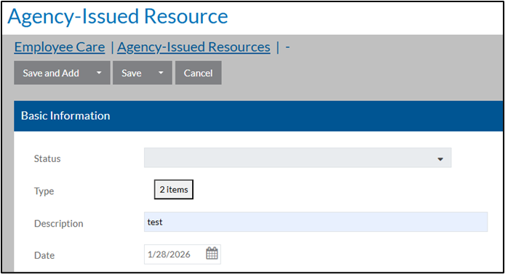
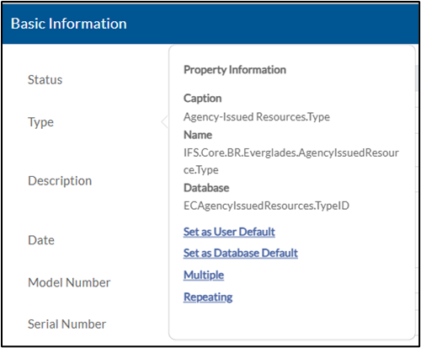


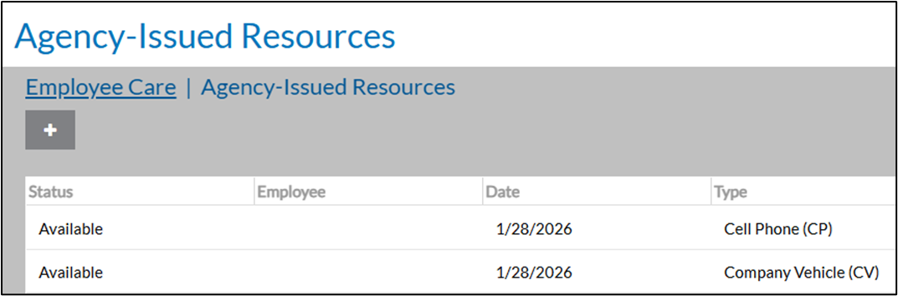
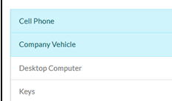
Multiple Values
Choosing Multiple Values
Left click and choose Multiple.
The field will be replaced with a button that says 0 items.
Click on the button for a list to choose from.
Saving Multiple Values
Fill out all other necessary information, then click Save.
An entry will be created for each selected item combination.

Slide 27
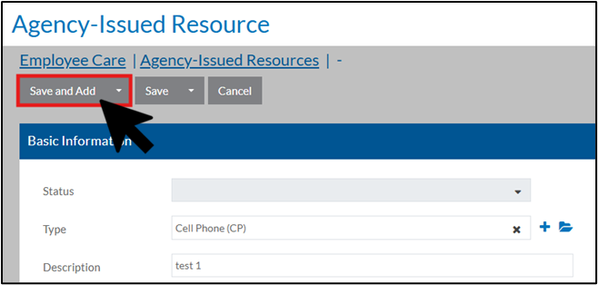
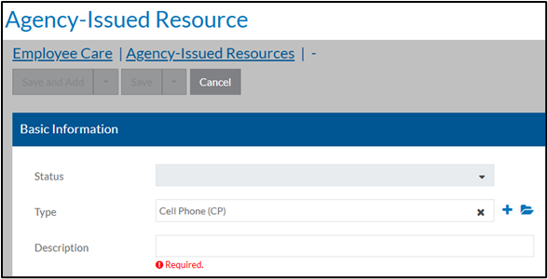


Repeating Values
Left click and choose Repeating in the Property Information bubble.
Fill the selection you would like to repeat as well as all other necessary information for that task.
Click Save and Add.
A record will be added. The system will then allow you to enter another item with the selection still in place.

Slide 28
Time Tracking
Enhanced Notes Functionality

Slide 29
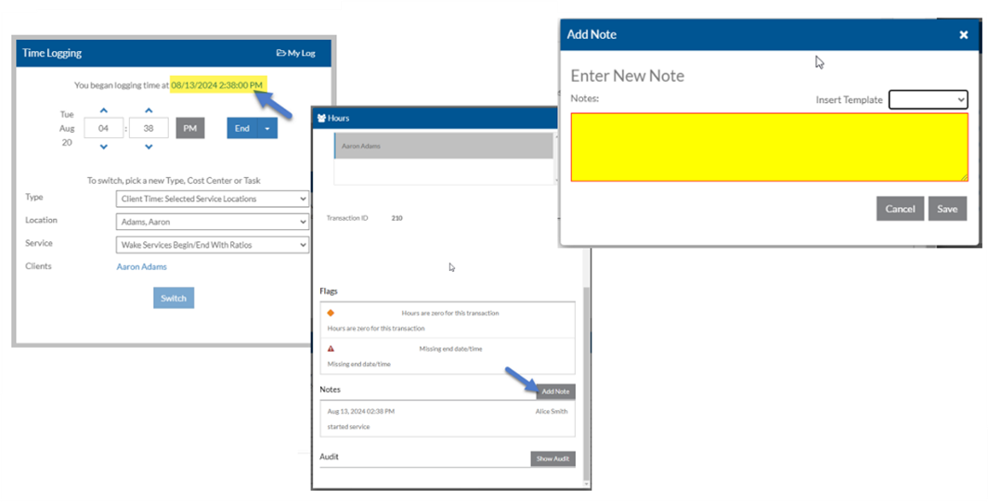
Notes In Progress and Editing Notes
Notes in Time Tracking transactions can now be added continuously throughout a shift and edited after completion (subject to staff and manager permissions). Prefill templates and required notes remain available.
More flexible note-taking during transactions.
Ability to edit or redact notes after entry.
Faster documentation with prefill templates.
Ability to require notes at start, update, or end.

Slide 30
In Progress Notes and Editing Note Detail
How It Works
Add notes at any point during a transaction.
Edit completed notes if your permissions allow.
Use prefill templates to quickly enter standard notes.
All changes are tracked in audit log.
What to Know
Editing completed notes is restricted by staff and manager data entry windows.
Notes can be added for In Progress or Completed transactions.
All changes are visible in audit logs.
When You Might Use This
You need to add notes continuously during a shift or transaction
Completed notes require update or correction
Notes need updated to redact sensitive information.

Slide 31
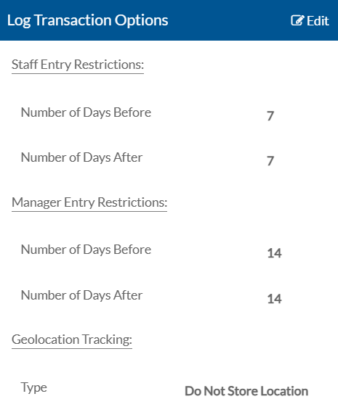
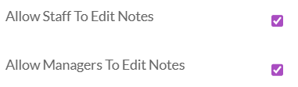
Adding In Progress Notes and Editing Notes Setup
Setup Ability to Edit Notes
Go to Setup > Time Tracking > Options.
Under Time Tracking Other Options check the box Allow Staff to Edit Notes if you would like staff to have the ability to edit notes, and/or check Allow Managers To Edit Notes to allow managers to edit notes of their Employee’s Time Tracking notes.
Lockout Window Options
Under Time Tracking Lockout Window Options, you can set restrictions around when time tracking entry can be entered and edited for Staff and Managers.

Slide 32
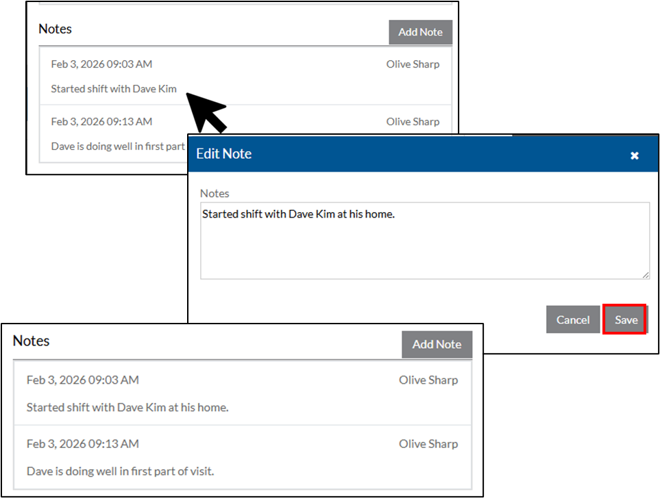
Adding In Progress Notes and Editing Notes
Adding Notes In Progress
Click on the visit time on your time log to bring up the visit details.
Scroll to the Notes section and click the Add Note button.
Add notes and click Save.
Editing Notes In a Visit
Click on the note you want to edit. Make updates and then click Save.
Edited note will now appear on the Time Tracking Log.
NOTE: Editing notes follows regular data entry windows.

Slide 33
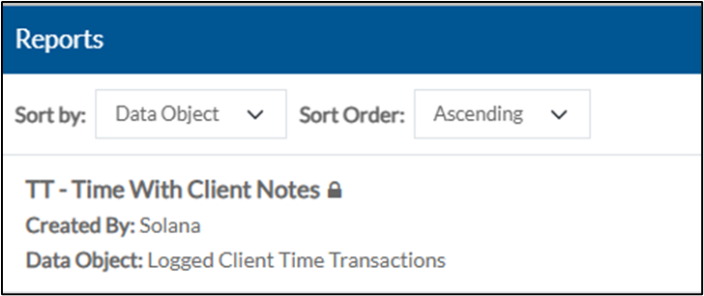
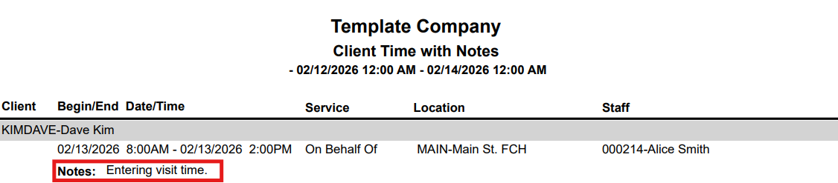
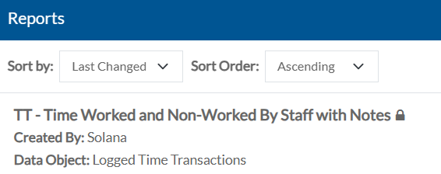
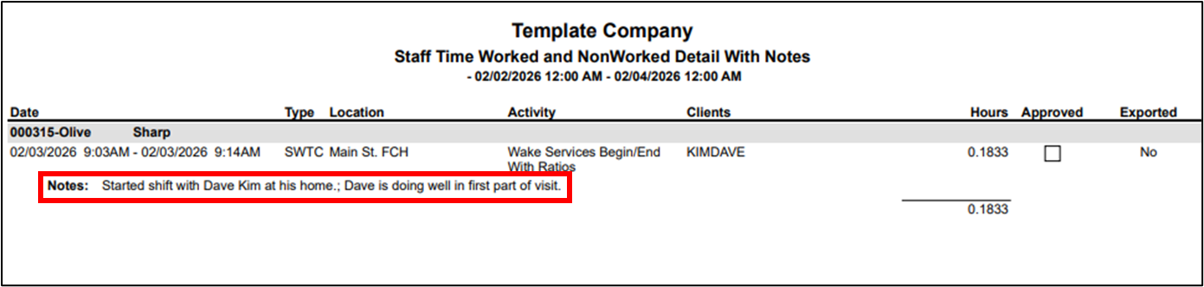
Reporting with Notes
TT - Time With Client Notes
TT - Time Worked and Non-Worked By Staff with Notes

Slide 34
A Closer Look Inside the Platform
Employee Care and Client Care Enhanced Save Options
Employee Care and Client Care Enhanced Field Options
Time Tracking Enhanced Notes Functionality
Now, we’ll jump into the system and highlight the key visuals — including the actual pages and fields.

Slide 35

Questions?
DataPlus Message Center Dynamic Groups
Staff Scheduling Staff Initiated Find Substitute Workflow
Employee Care and Client Care Enhanced Save Options
Employee Care and Client Care Enhanced Field Options
Time Tracking Enhanced Notes Functionality

Slide 36
What’s Next?
Focused support to help you adopt these features in the next 30-60 days
Explore and experiment with the new features in your databases
Submit requests for assistance, we’re here to support you
Coming in April
Our next Lunch(ish) and Learn will cover all things Requirements, including how any cyclical processes can benefit from a structured requirements setup.

Slide 37
Thank you!

